Slide 1
ВСЕРОССИЙСКАЯ ОЛИМПИАДА ШКОЛЬНИКОВ ПО АНГЛИЙСКОМУ ЯЗЫКУ
2024-2025 УЧЕБНЫЙ ГОД
( 9 класс)
Разбор заданий

Slide 2
LISTENING
(10points)
Time: 10 minutes
For items 1–10, listen to a radio talk for young people about astrology, and decide whether the statements 1–10 are TRUE according to the text you hear, or FALSE, or the information on the statement is NOT STATED in the text. You will hear the text twice.
1. The movement of stars determines people’s lives. False
2. Most people have no faith in astrology. False
3. Should they decide on a serious issue, a small percentage of people are likely to turn to the stars. True
4. Simon agrees with psychologists on the influence of a person’s time of birth on their personality. True
5. The time of birth remains a defining factor throughout the whole life. False
6. A statistical comparison between the person’s choice of career and their star sign is the most effective tool in predicting future events in their life. Not stated
7. More than 15 % of entertainers were born in the second half of summer. True
8. Spring is a favourable period for travelling and finances. Not stated
9. People in financial professions are connected with one particular star sign. False
10. Technological advances have reduced the influence of nature on us. True

Slide 3
READING
(15 points)
Time:30minutes
Read an extract from a novel and answer questions 1–15.
For statements 1–7, choose TRUE if the statement agrees with the information given in the text; FALSE if the statement contradicts the information given in the text, or NOT STATED if the information on the statement is not given in the text.
1. The Eleventh Edition will be published before 2050. Not stated
2. According to Syme, people will have to do with only six words in putting across their ideas. False
3. It was Syme’s elder brother who came up with the idea of Newspeak. False
4. Winston’s articles are written in Newspeak. True
5. Winston expressed his false sympathy for Syme’s ideas with a smile, as he was afraid that words might reveal his true feelings. True
6. Human consciousness will contract as there will be fewer words to think with. True
7. Ingsoc is a new word in Newspeak denoting revolution Not stated

Slide 4
8.WinstonandSymeare
  inacafeteria.
  ataparty.
  atschool.
  inanoffice.
9.Symelikes
  the food.
  hearingWinston'sopinions.
  talkingabouthiswork.
  toshout.
10.Syme'sworkwiththedictionaryinvolves
  inventingnewwords.
  eliminatingwords.
  explainingatheory.
  teachingpeopletothink.
11.Whatkindofwordsarebeingthemostgreatlyreduced?
  adjectives
  verbsandadjectives
  nouns
  everythingexceptantonyms

Slide 5
12.What does the author show in the lines in bold?
  Winston tries to seem appreciative but is not really.
  Winston has great e thusiasm for Newspeak.
  Syme doubtsтWinston but this is unjustified.
  Winston does not believe a word that Syme has said.
13.What can began there about Winston's attitude towards Newspeak?
  He find sit exciting.
  He studies it eagerly.
  He is out spokenly against it.
  Heacceptsitunhappily.
14.Which of the following best describes Newspeak?
  It is a historical language being reconstructed.
  It is a highly simplified language designed to prevent thought.
  It was invented to help citizens escape an oppressive government.
  It is a new language that is incredibly difficult to learn.
15.What kind of future does Syme imagine?
  Everyone will be better educated.
  People will be safe because there will be no violent crime.
  People will not have enough language to think at all.
  People will communicate better and more effectively.

Slide 6
USE OF ENGLISH
(20 points)
Time: 30minutes
Part 1
For items 1-15, read the text below and look carefully at each line. Some of the lines are correct, and some have a word which should not be there. If a line is correct, put a tick (V). If a line has a word which should not be there, write down the word. There are two examples at the beginning (0 and 00).

Slide 7
The house painters Last week some painters came round to | 0
Paint my house. I usually do this kind of a job | 00
myself, but I've been here very busy for the last here | 1
month. So I called a more local decorating firm, more | 2
And they agreed to do it for a reasonable price. V | 3
Three men arrived on Monday the morning to the | 4
paint the out side walls. Of course, they were used were | 5
the wrong colour and spilt paint all over the v | 6
front door. Some one of the windows one | 7
Upstairs were open, and some of paint went of | 8
inside the house and ruined both the carpet in both | 9
the living-room.They also broke a window. V | 10
I phoned their company,and the manager v | 11
as sured me that they would repaint than the than | 12
walls.Then I went away on a business. A | 13
I've just come back, and the walls are a different colour, v | 14
But it is still such the wrong colour. If I had done the job such | 15
my self, I would have finished it by now.

Slide 8
Part 2
Foritems1-5,matchthetwocolumnstomakeEnglishproverbs. Intherightcolumn, there are three extra phrases you don’t need. There is an example at the beginning.
0 | Necessity is | A | Cannot change its spots.
1 G | Actions speak | B | than sorry.
2 I | A ca tin gloves | C | better than no bread.
3 C | Half a loaf is | D | gets the worm.
4 B | Better safe | E | them other of invention .
5 A | The leopard | F | the best policy.
 |  | G | louder than words.
 |  | H | than never.
 |  | I | catches no mice.

Slide 9
WRITING(15 points)
Time: 40minutes
Write a short description of any monument which is devoted to World War II and recommend it to foreign tourists.
Write the name of the monument at the beginning on a separate line (words are not countedin this line). The monument should be real, not imaginary.
Remember to mention in your description:
What the monument looks like;
Where the monument is located;
Why your ecommendit to foreign tourists.
Write100 - 140words.

Slide 10
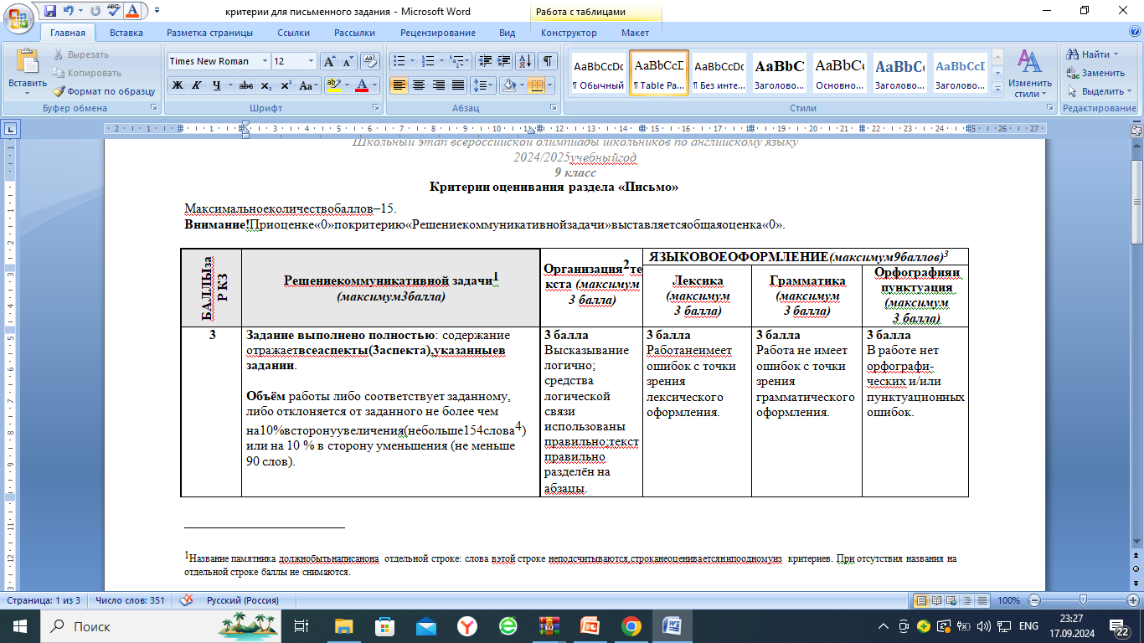

Slide 12
